Slide 1
Module 2 Data Sharing (NCBI and Strain-specific databases)
16th of March, 2021
Ayorinde O. Afolayan
Global Health Research Unit for the Genomic Surveillance of Antimicrobial Resistance (GHRU-GSAR), Department of Pharmaceutical Microbiology, Faculty of Pharmacy, University of Ibadan, Oyo State, Nigeria

Slide 2
Outline
Overview of GenBank and NCBI
Submission of sequence data to GenBank
Overview of Strain-specific Databases
Submission of data to Klebsiella species complex database

Slide 3
GenBank
A sequence database housing publicly available DNA sequences (and annotation) submitted by the scientific community around the world (https://www.ncbi.nlm.nih.gov/genbank/).
International Nucleotide Sequence Database Collaboration:
DNA DataBank of Japan (DDBJ),
European Nucleotide Archive (ENA), and
GenBank at NCBI
These three organizations exchange data on a daily basis.

Slide 4
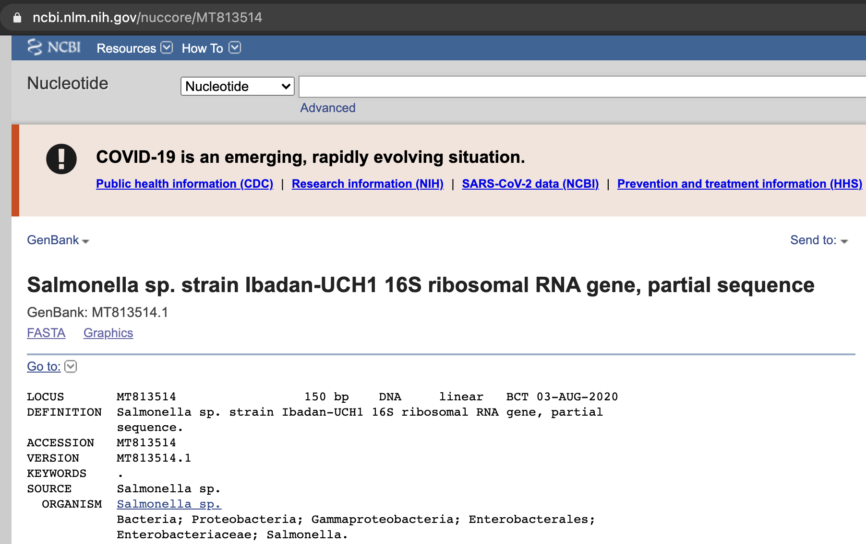
How to Search and Retrieve Data from GenBank
Via the Entrez Nucleotide website within NCBI (https://www.ncbi.nlm.nih.gov/nucleotide/). Input queries (on the search bar) could be e.g. accession numbers, or name of organism.

Slide 5
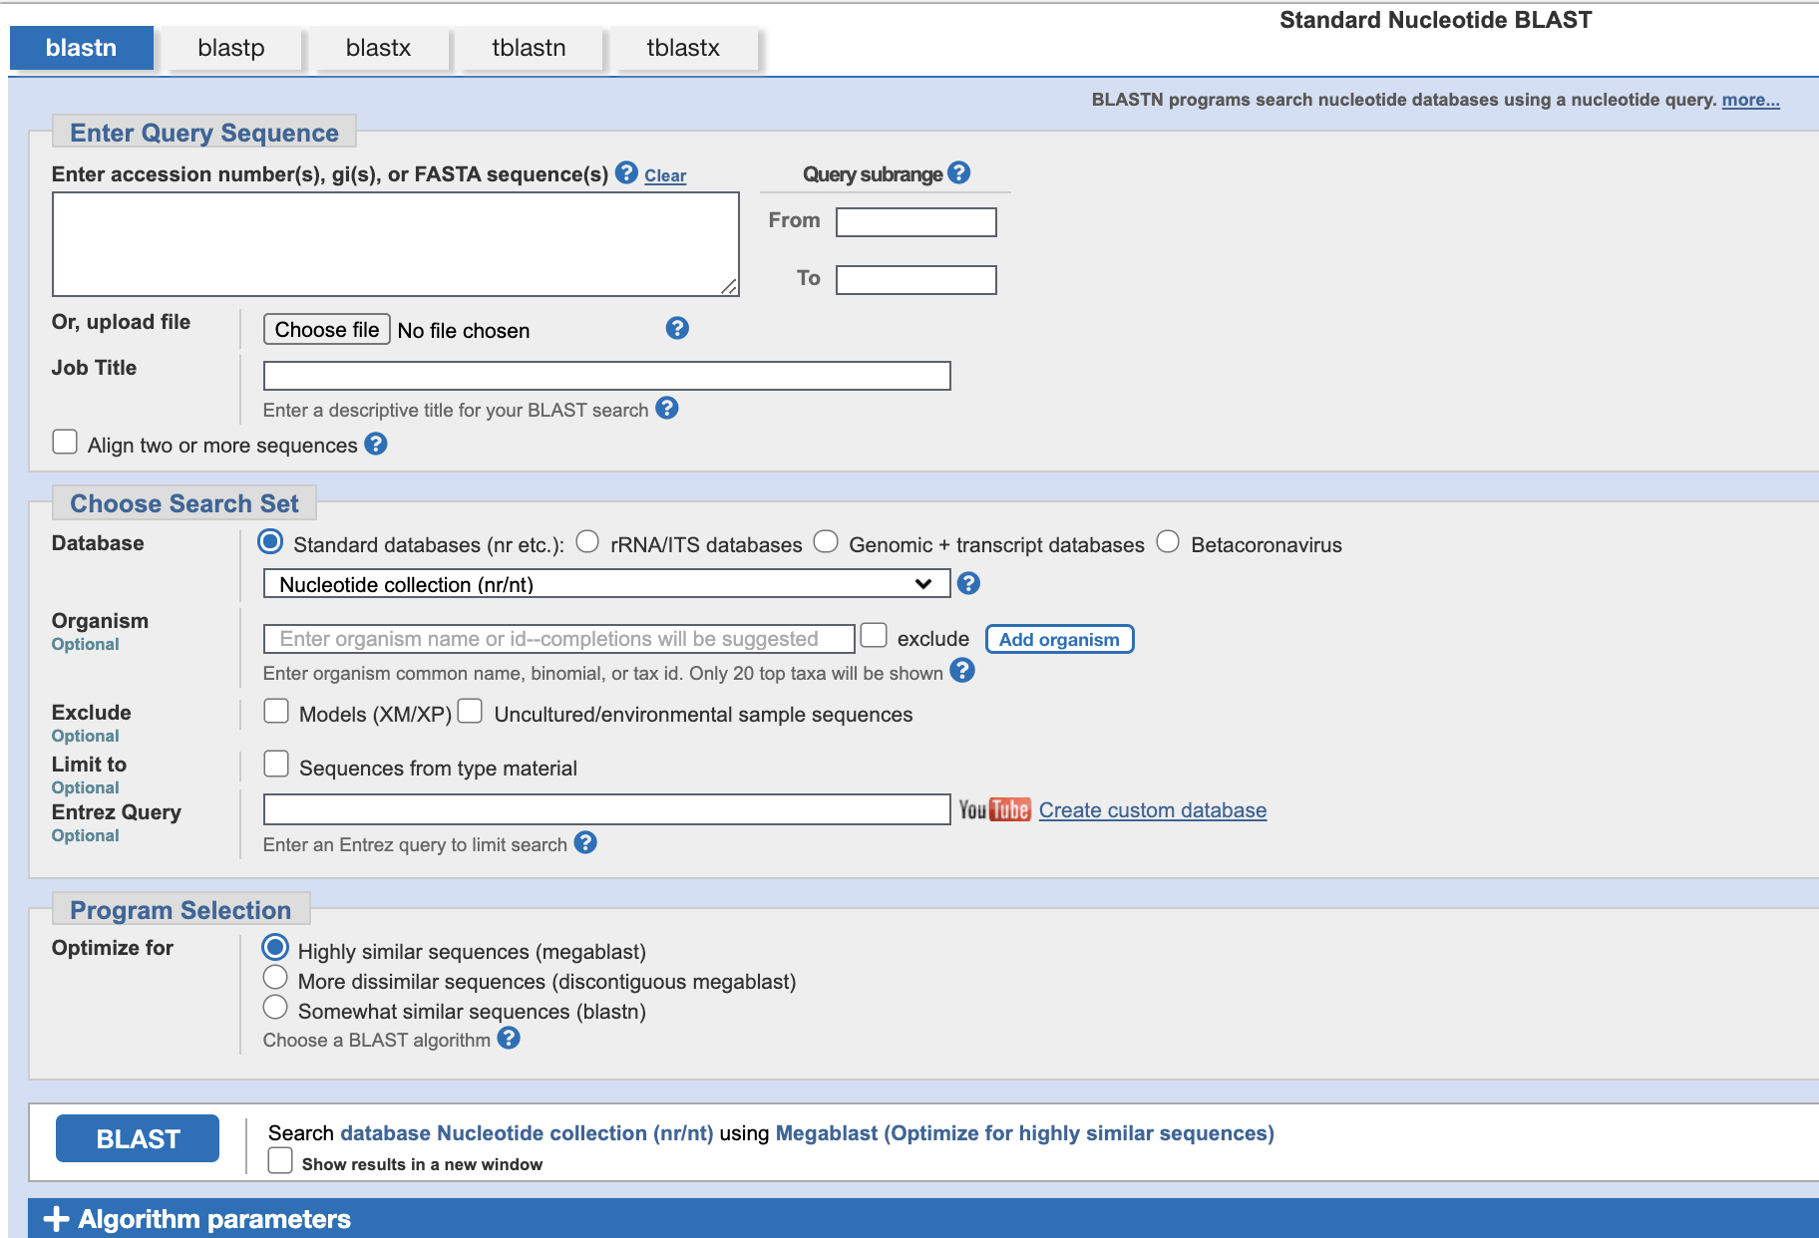
How to Search and Retrieve Data from GenBank
Search for GenBank sequences identical to your sequences using the different BLAST tools (https://blast.ncbi.nlm.nih.gov/Blast.cgi).

Slide 6
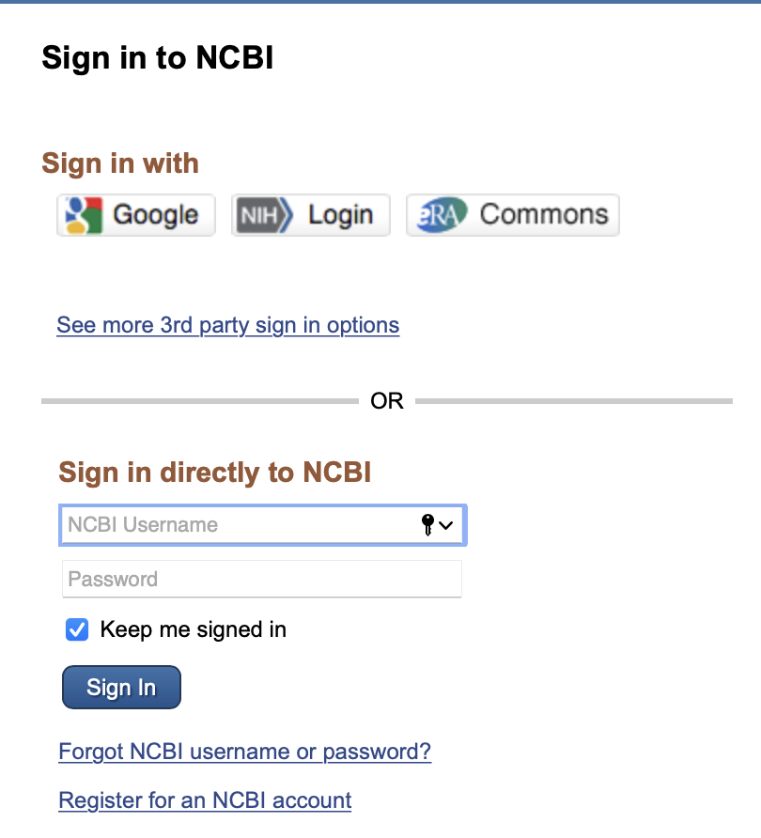
Submission to GenBank: Register
It is advisable to register for an NCBI account first, before beginning the process of submission (https://www.ncbi.nlm.nih.gov/account/?back_url=https%3A%2F%2Fwww.ncbi.nlm.nih.gov%2F).

Slide 7
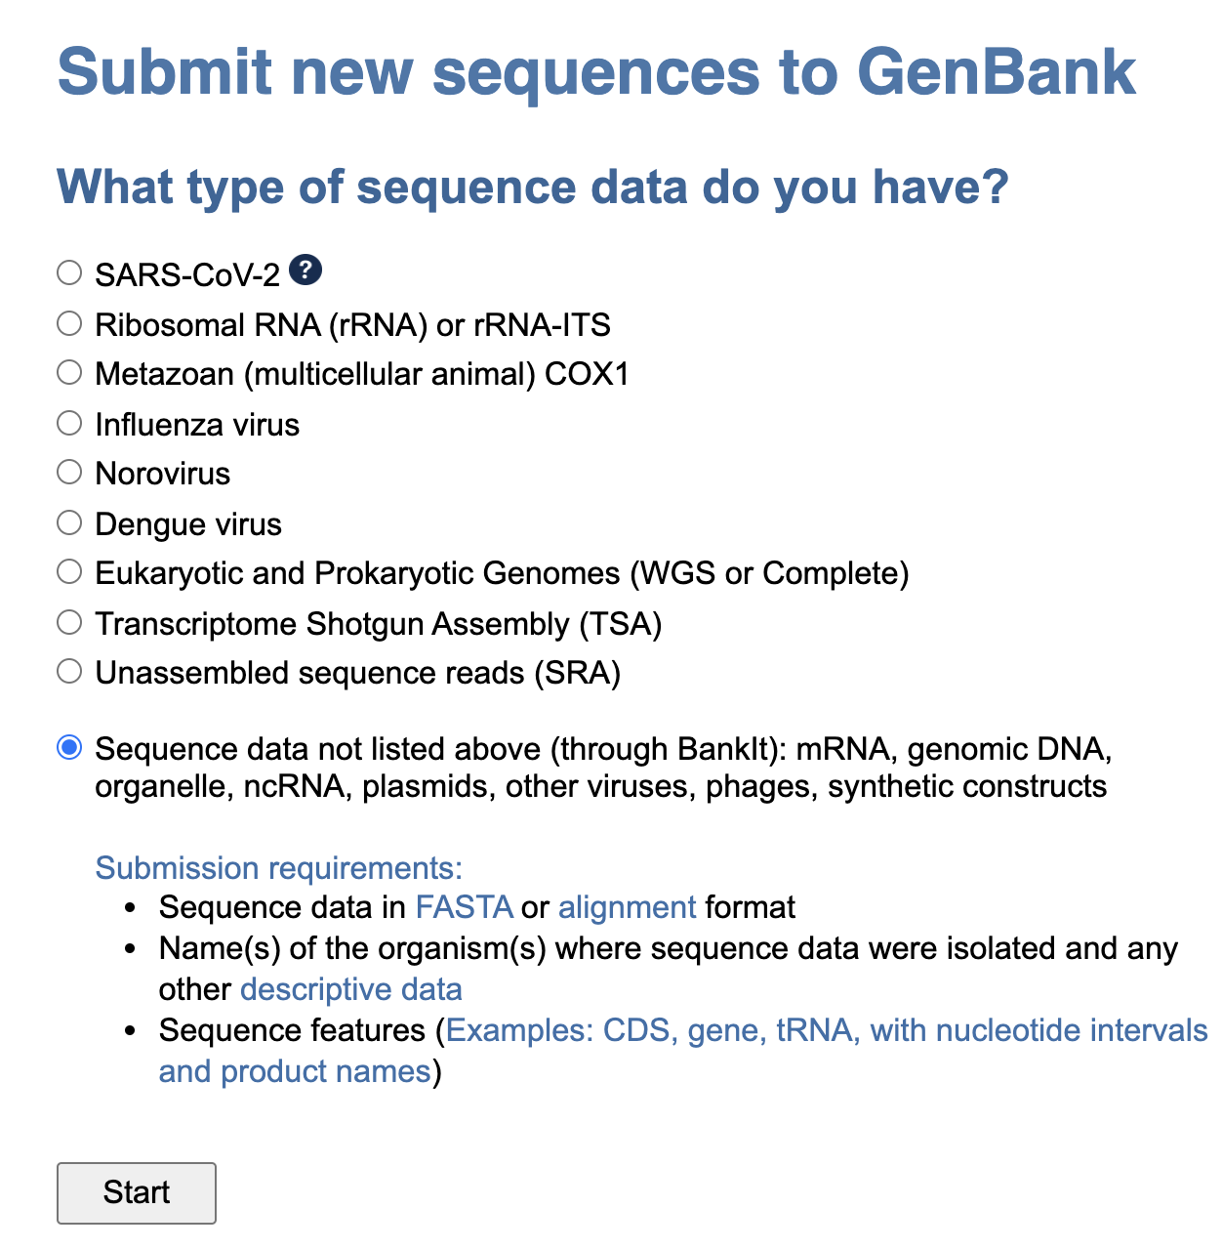
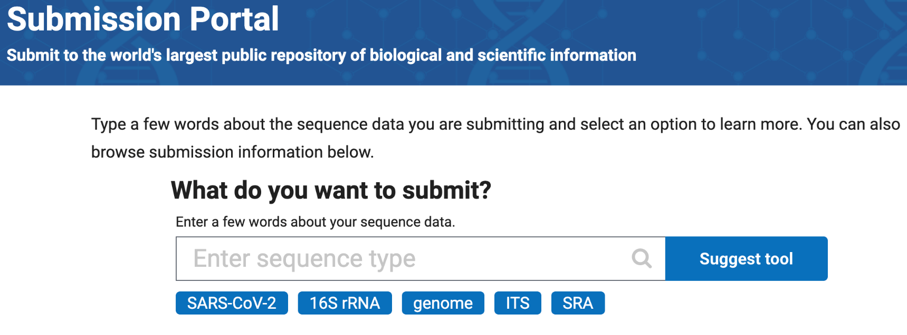
Submission to GenBank: Submission Types
BankIt https://www.ncbi.nlm.nih.gov/WebSub/ directs one to the appropriate submission database.
Submission portal
https://submit.ncbi.nlm.nih.gov/

Slide 8
Submission to GenBank: Submission Requirements
The submission must include information about the source organism and annotation provided by the submitter. (E.g., organism identity, source of collection, geographical location, date of collection, type of sequencer etc).
The submission must not be:
Non-contiguous sequences
Primer sequences
Protein sequences with no underlying nucleotide submission
Sequence containing a mix of genomic and mRNA sequence
Sequences without a physical counterpart (consensus sequences)
Sequences with length less than 200 nucleotides

Slide 9
Example: Submission to SRA

Slide 10
Example: Submission to SRA

Slide 11
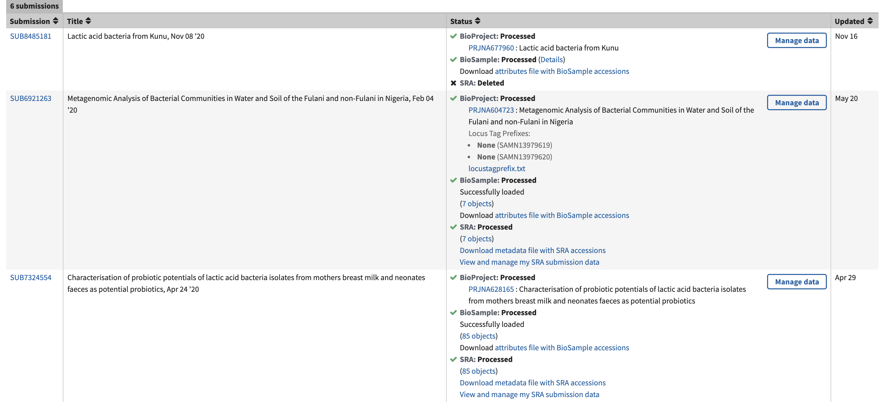
Submission to GenBank: After approval, what next?

Slide 12
Strain-specific Databases
PubMLST (https://pubmlst.org/): An open access database containing genotypic and phenotypic information for > 100 microbes.

Slide 13
Strain-specific Databases:
Enterobase (https://enterobase.warwick.ac.uk/)

Slide 14
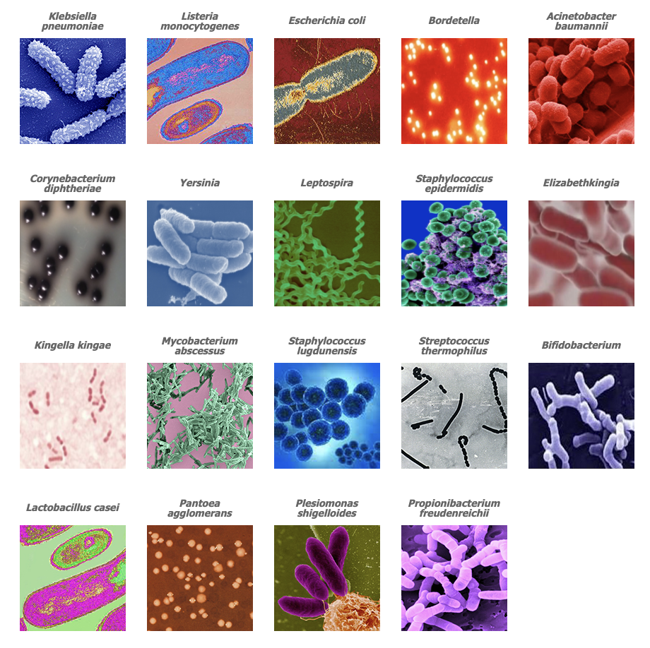
Strain-specific Databases
BIGSdb-Pasteur (https://bigsdb.pasteur.fr/): Hosts several databases based on multilocus sequence typing (MLST), whole genome based typing and supplementary schemes (in particular, antimicrobial resistance or virulence genes).

Slide 15
Klebsiella species complex database
Here (https://bigsdb.pasteur.fr/klebsiella/klebsiella.html) we find genomic data and genotypic definitions for isolates of the K. pneumoniae species complex (also called K. pneumoniae sensu lato, i.e., including K. pneumoniae, K. quasipneumoniae, K. variicola and related taxa) based on
Multilocus Sequence Typing (MLST),
core genome MLST (cgMLST),
ribosomal MLST (rMLST),
capsular typing (wzc and wzi sequencing) and
MLST of virulence gene clusters

Slide 16
Klebsiella species complex database
There are two databases within the Klebsiella species complex database:
Sequences and profile database
Isolates database
To submit isolates (with novel sequence types for curation and assignment of STs) or alleles or MLST profiles, one must first log in to the respective databases (temporary username and password is given by Klebsiella curators if contacted (klebsiellaMLST@pasteur.fr)).
One could also search the Klebsiella species complex database for alleles or profiles of interest, and dowload for subsequent analyses.

Slide 17
Klebsiella species complex database
Sequence and profile database login (https://bigsdb.pasteur.fr/cgi-bin/bigsdb/bigsdb.pl?db=pubmlst_klebsiella_seqdef&page=login).
Login Submission Manage Submissions Choose submission type (alleles or MLST profiles).

Slide 18
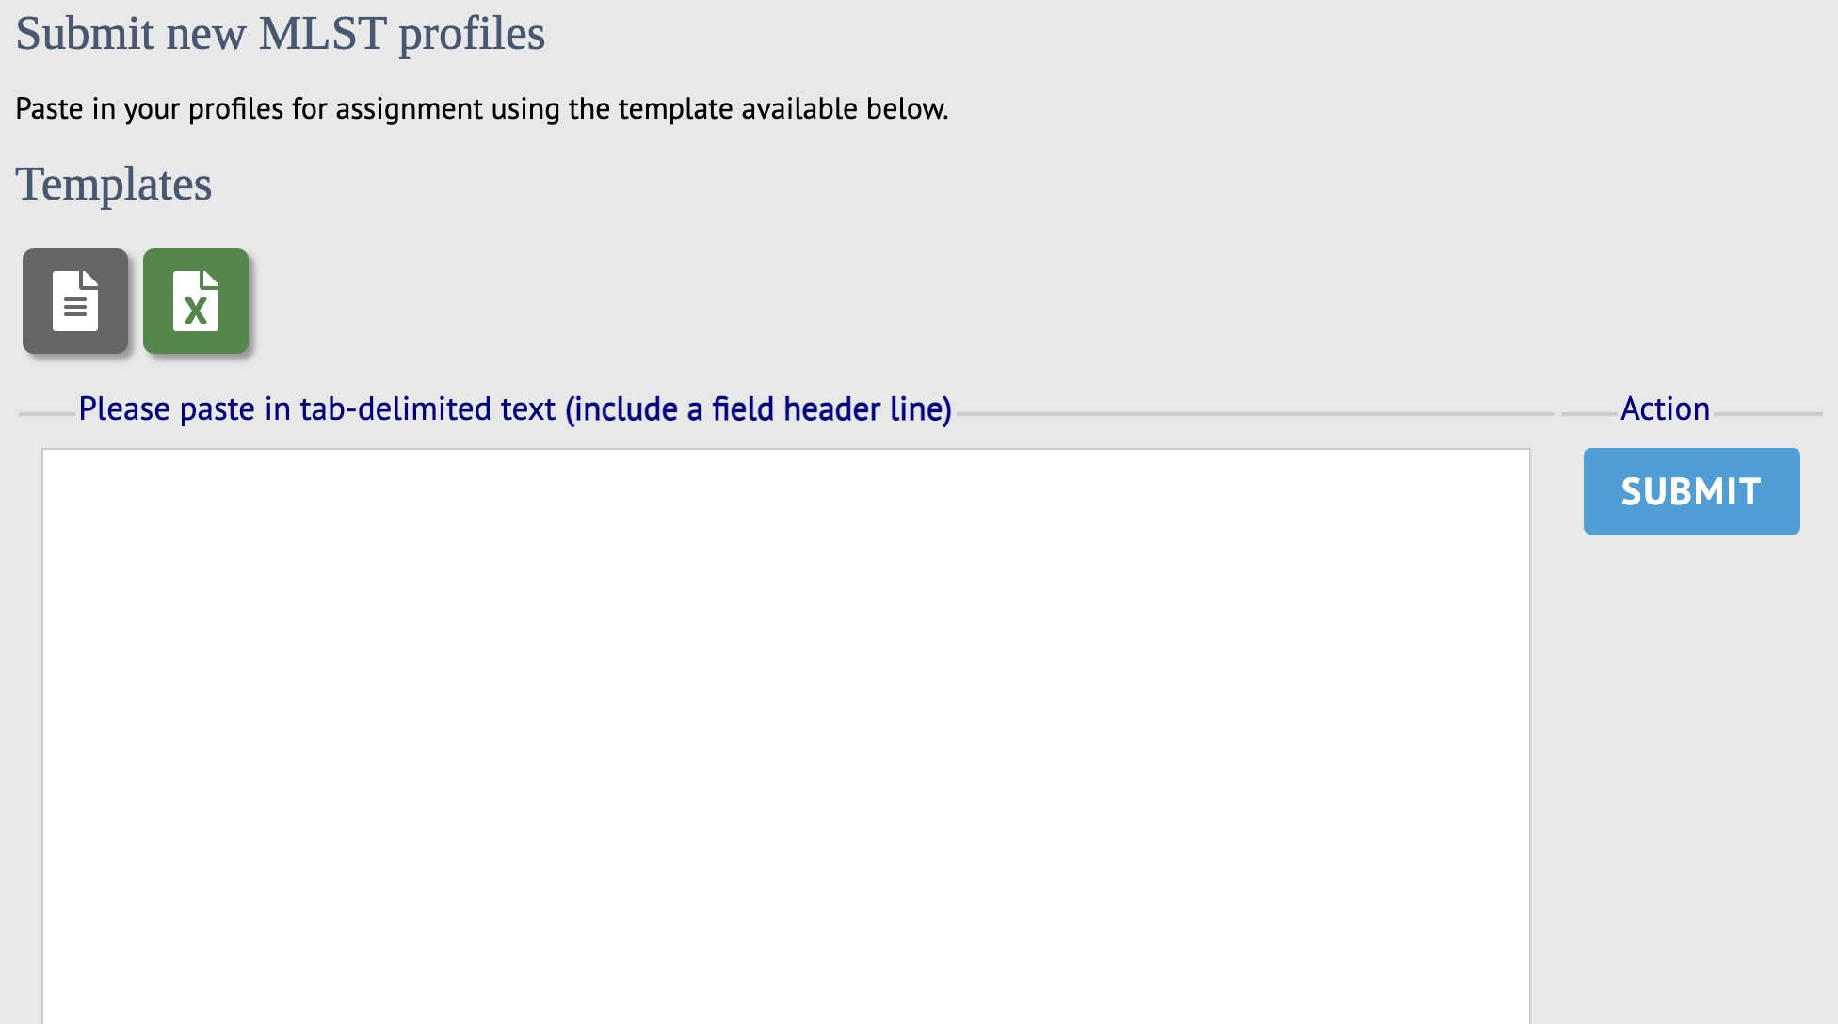
Klebsiella species complex database: Submission type (allele/MLST profile) within the Sequence and profile database

Slide 19
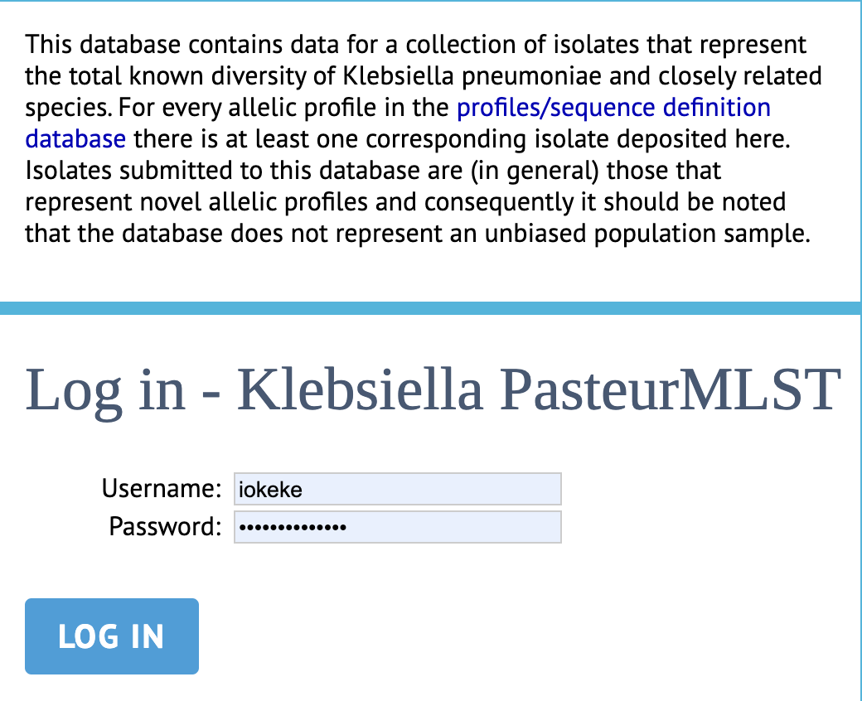
Klebsiella species complex database
Isolate database login (https://bigsdb.pasteur.fr/cgi-bin/bigsdb/bigsdb.pl?db=pubmlst_klebsiella_isolates).
Login Submission Manage Submissions Choose submission type
isolates (without assembly files)
genomes (isolate records with assembly files)

Slide 20
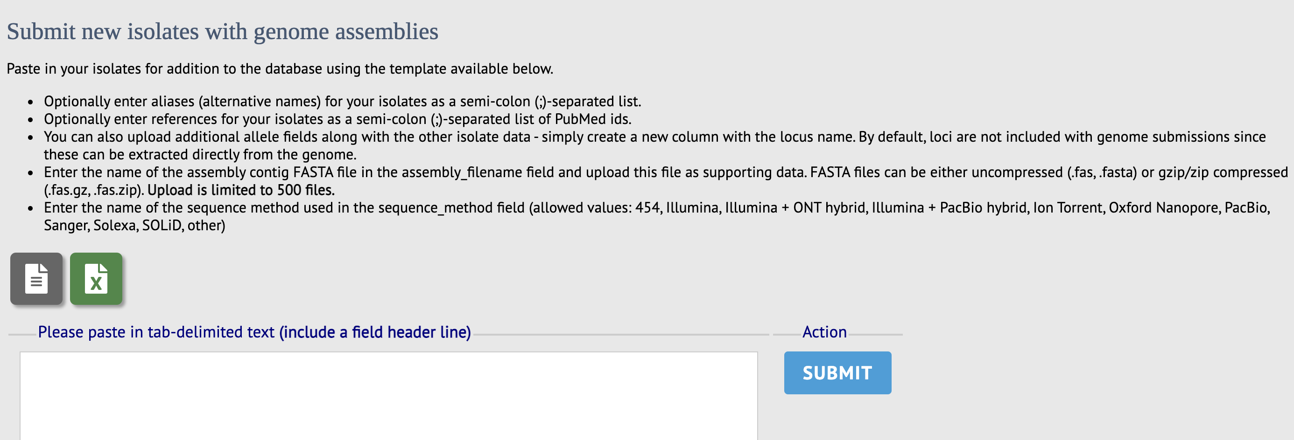
Klebsiella species complex database: Submission Type (isolates/genomes) within the Isolates database.

