Slide 1
WGS workflow: from isolate to analysis – Day 1
Sequencing workflow
22 March 2021
Pernille Nilsson

Slide 2
Virtual Housekeeping
Please turn off your cameras and microphones – this will help with bandwidth and maximise audibility.
Do frequently use Slack to share comments and ask questions. Keep the chat constructive, respectful and on topic!
For Q&A’s use Slack to submit your questions! Please upvote (give a thumbs-up) to the questions that you like.
The session is being recorded for distribution to participants as a post course resource as well as for future iterations of the course.
Notes:
Like for everyone, the COVID-19 pandemic presented many challenges for the Fleming Fund. We are primarily a programme focusing on bacteriology, so was there much we could do to support the response? And was it our place?
While we initially thought that there wasn’t much cross over between bacteriology and laboratory capacity, feedback showed that the programme’s inherent design and funding of activities have contributed to national pandemic responses. Grantees and governments reported renovating and upskilling laboratories, training staff and supporting cross-governmental collaboration were most useful.
In some country grants, like Nepal, Fleming Fund resources were used to support the COVID response directly, such as biosafety cabinets, PPE, a deep freezer, and even a microbiologist.
We also flexed specific grants, such as the Regional Whole Genome Sequencing Grant, to be used for the COVID response. This is a very exciting investment, because it means that genome sequencing is being used to track the spread of COVID-19 across Africa in real-time.
Fellows have also been working hard on the COVID response in their own countries, in addition to their Fleming Fund responsibilities.
“Although COVID-19 is not a focus of the Fleming Fund Country Grant in Timor-Leste, their team has indirectly helped the country respond to COVID-19. Strengthening the laboratory system, in particular the National Health Laboratory, has provided vital support to the Ministry of Health in their efforts to protect the health of the Timorese people.”
“Support from the Fleming Fund has helped increase sequencing capacity and analysis within the NICD. “Increasing sequencing in Africa is huge. There are many countries that haven’t done this before and now we can support them,” said Jinal. The Fleming Fund is also funding a bioinformatics scientist who will be able to help other countries interpret the genomics data.”

Slide 3
Day 1: Monday – 22 March 2021 – Sequencing workflow Join Zoom
Time (CET) | Content | Lecturer/ Facilitator
08.45 – 09.00 | Joining the call – Assistance will be provided at this time to help participants join
09.00 – 09.15 | Welcome and Introduction (Live)
09.15 – 09.45 | [1] Introducing the workflow: Going from bacterial isolate to Genome – Synopsis of all the steps. (Pre-recorded Lecture) | Anderson Oaikhena (University of Ibadan, Nigeria)
09.45 – 10.00 | BREAK
10.00 – 10.30 | [2] DNA purification: From bacterial culture to high quality DNA. Different methods will be presented covering commercial kits and automated DNA extraction systems. (Pre-recorded Lecture) | Shannon Williams (NICD, South Africa)
10.30 – 10.45 | [2E] Exercise: Investigating quality checks on isolated DNA. (Live introduction to the exercise). Results are to be handed in via this Survey Monkey link prior to Day 4. | Shannon Williams (NICD, South Africa) & Beverly Egyir (NMIMR, Ghana)
10.45 – 11.00 | Q&A and Wrap-up (Live)
Agenda Monday 22nd March 09:00 – 11.00
Lectures
Exercises
SurveyMonkey

Slide 4
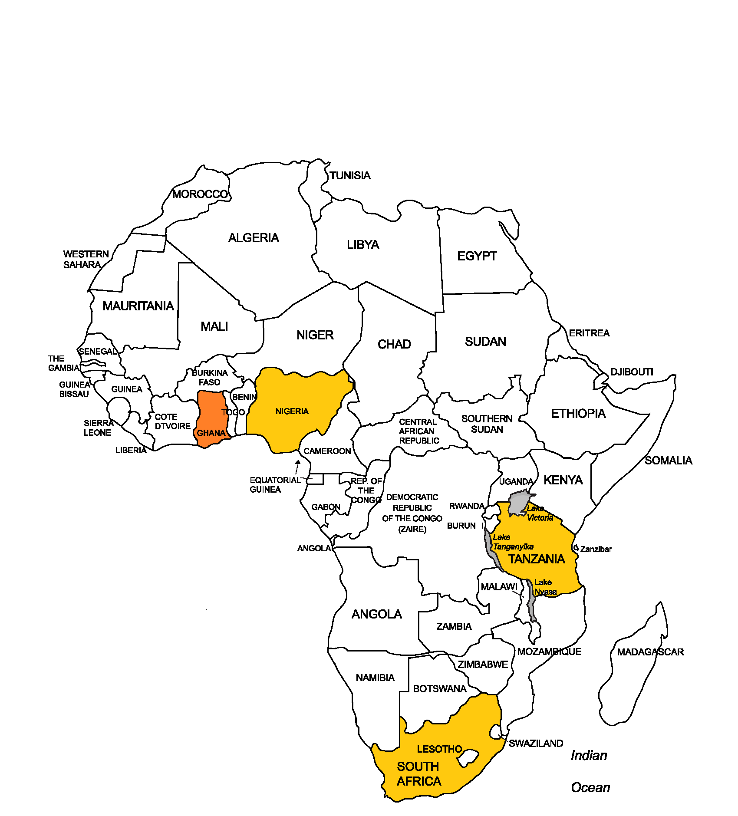
SEQAFRICA – Extending whole genome sequencing capacity for AMR Surveillance
Led by the Research Group for Global Capacity Building at the National Food Institute (DTU Food).
Established and currently support a consortium of regional and national sequencing centres
Nigeria, University of Ibadan (UI)
Tanzania, Kilimanjaro Clinical Research Institute (KCRI)
South Africa, National Institute for Communicable Diseases (NICD)
Ghana, Noguchi Memorial Institute for Medical Research (NMIMR)
South Africa, NICD, SARS-CoV-2

Slide 5
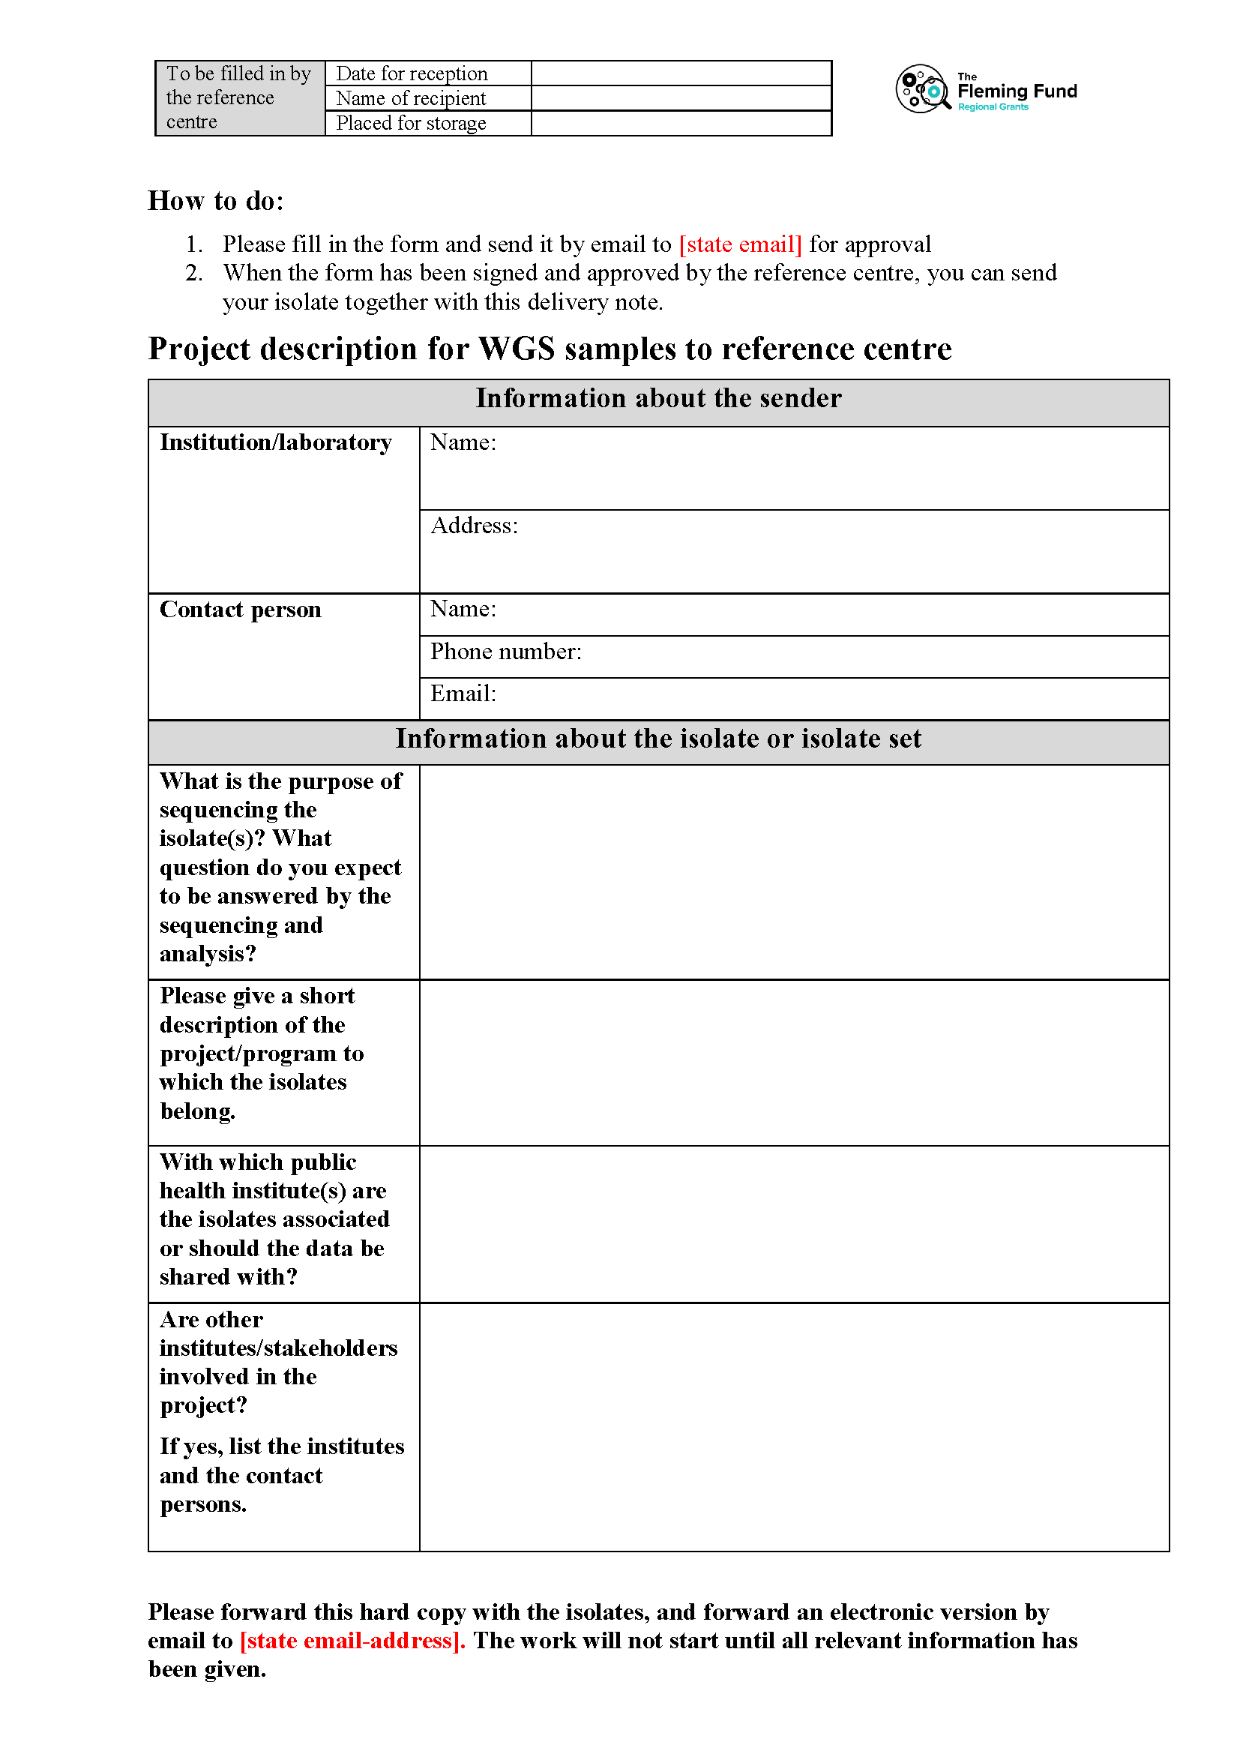
Resources we provide
WGS and data analysis services to the African region
Support genomic surveillance and investigation of
Outbreaks
Unusual resistance phenotypes
Delineation of the flow of organisms/genes in a One Health framework

Slide 6
[1] Introducing the workflow Anderson Oaikhena (University of Ibadan, Nigeria)
ATCGAT
ATCGAT

Slide 7
BREAK
(short)
9.30 to 9.45 CET

Slide 8
[2] DNA purification: From bacterial culture to high quality DNA. Shannon Williams (NICD, South Africa)
ATCGAT
ATCGAT
[2b] MagCore Automated DNA extraction
[2c] Qiagen Overview
[2d] Qiagen Dneasy protocol
[2e] Nanodrop Spectrophotometer
[2f] Qubit Fluorometer

Slide 9
[2E] Exercise: Investigating quality checks on isolated DNA Shannon Williams (NICD, South Africa) Beverly Egyir (NMIMR, Ghana)
ATCGAT
ATCGAT

Slide 10
Q&A

Slide 11
Day 2: Wednesday – 24 March – Illumina and ONT sequencing Join Zoom
08.45 – 09.00 | Joining the call – Assistance will be provided at this time to help participants join
09.00 – 09.15 | Welcome and Introduction (Live)
09.15 – 09.45 | [3] Illumina library prep: Going from high quality DNA to sequencing libraries. (Pre-recorded Lecture) | Happiness Kumburu (KCRI, Tanzania)
09.45 – 10.00 | BREAK
10.00 – 10.30 | [4] Illumina sequencing: Hands-on how to load the machine with your prepared libraries. (Pre-recorded video) | Happiness Kumburu (KCRI, Tanzania)
10.30 – 10.45 | [5] Downloading data: Once the sequencing run is finished, how do you get your data? (Pre-recorded video / Demonstration) | Stanford Kwenda (NICD, South Africa)
10.45 – 11.00 | [5E] Exercise: Introduction to an exercise to recap QC of sequence output. (Live introduction to the exercise). To be handed in via SurveyMonkey prior to Day 4. | Pernille Nilsson (DTU, Denmark)
11.00 – 11.30 | BREAK
11.30– 12.30 | [6] Introduction to Nanopore sequencing: (Live Lecture/ Demonstration). | Charles Kayuki (ONT)
12.30 – 12.45 | Q&A and Wrap-up (Live)
Agenda Wednesday 24th March 09:00 – 12:45

Slide 12
Contact us for more information
seqafrica@food.dtu.dk
pnil@food.dtu.dk
(Pernille Nilsson, Project Manager)
rshe@food.dtu.dk
(Rene S. Hendriksen, Technical Lead)
antimicrobialresistance.dk/seqafrica.aspx
@AfricaSeq

