Slide 1
Salmonella Vejle - foodborne disease outbreak
September 2020.
Outbreak occurred in the KwaZulu-Natal Province of South Africa.
Outbreak occurred among members of the same family/household.
The family slaughtered a goat - the goat meat was prepared and consumed.
The following day, all persons that consumed goat meat presented with symptoms of stomach cramps, diarrhoea and vomiting.
15 cases.
Salmonella cultured from the stool specimens of all cases.
Salmonella Vejle.
Five isolates available for whole-genome sequencing analysis.

Slide 2
Whole-genome sequencing (WGS) analysis
Five isolates were further investigated using WGS.
Illumina NextSeq technology.
Sequencing data were uploaded the EnteroBase platform (http://enterobase.warwick.ac.uk/species/index/senterica).
Open the EnteroBase platform (http://enterobase.warwick.ac.uk/species/index/senterica) and register yourself as a user. Now ‘Log in’ to the platform.
Perform the following steps.
Click on ‘Search Strains’ to open the search box. Under ‘Strain metadata’, search the database as follows: Country equals ‘South Africa’ AND Serovar equals ‘Vejle’ AND Collection Year equals ‘2020’ AND Collection month equals ‘9’. Click submit.
How many isolates have been found?

Slide 3
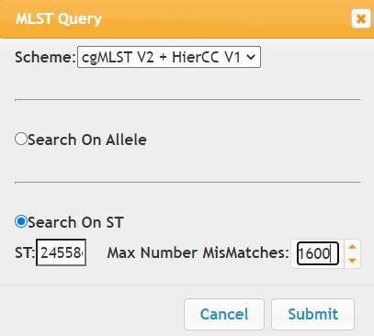
Review the ‘Experimental Data’ found for the isolates.
Under the ‘Experimental Data’, open the ‘Serotype’ data output for the isolates - do results concur with the serovar data we uploaded in our ‘Strain meta data’?
Under the ‘Experimental Data’, open the ‘7-gene MLST’ data output. What is the MLST subtype number for these isolates?
Under the ‘Experimental Data’, open the ‘cgMLST V2’ data output.
Create a ‘MLST GrapeTree’ using the ‘MSTree V2’ algorithm.
Review the ‘GrapeTree’ and comment on the genetic relatedness of the outbreak isolates - how many allele differences occur among the isolates? - would you consider our outbreak isolates to be highly related?
Go back to the table showing all the data for the isolates.
Using the cgMLST data, select one of our outbreak isolates and right-click on the ST column for the isolate, and search for nearest/closest matches in the database - with the ‘Max Number MisMatches’ set to ‘1600’ (this was demonstrated in my presentation).

Slide 4
Review output results.
How many isolates did your search return?
Review the nearest isolates to our ‘outbreak cluster’ by clicking on the ‘differences’ column and listing isolates from the smallest to largest number. Our outbreak cluster should now be on top of the list. Are there any identical or near matches to our ‘outbreak cluster’ in the same timeline (September 2020)? Which isolate is the closest match to our ‘outbreak cluster’, from which country was it isolated and by how many allele differences is it different to our ‘outbreak cluster’?
Create a ‘MLST GrapeTree’ of all the isolates using the ‘MSTree V2’ algorithm.
Review the ‘GrapeTree’ to visualize the data. Colour the nodes by ‘country’.
Would you consider Salmonella Vejle to be a Salmonella serotype that is commonly isolated worldwide and is therefore well represented (by thousands of entries) in the EnteroBase database OR is Salmonella Vejle rarely reported in the database.

